Slide 1


ENGINEER
ENGINEER
AMAN KUSHWAHA

Slide 2
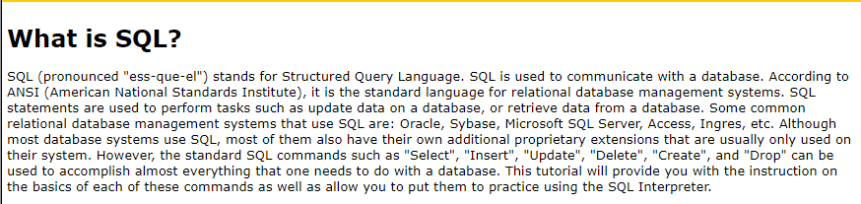

Slide 3
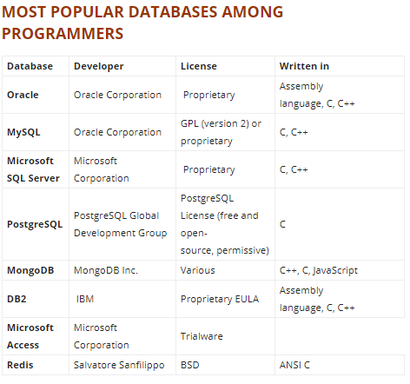

Slide 4
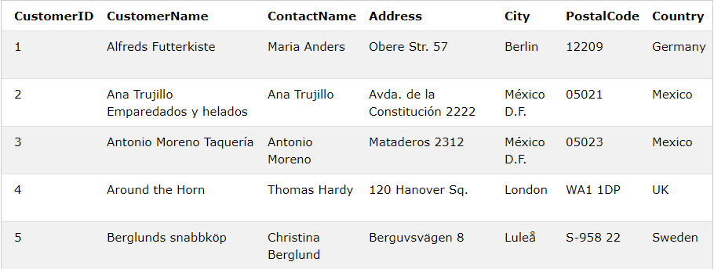

Slide 5
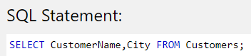
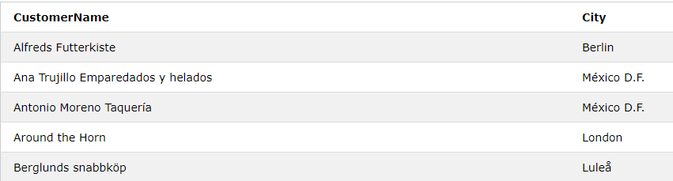

Slide 6
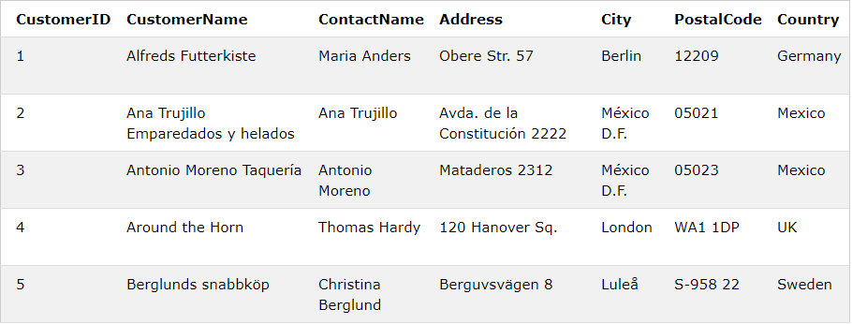
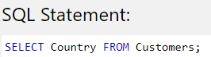
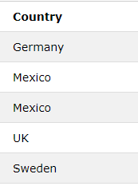

Slide 7
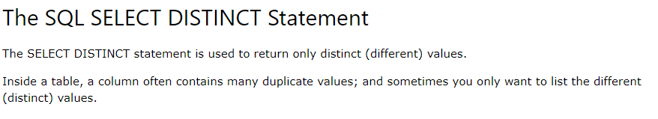
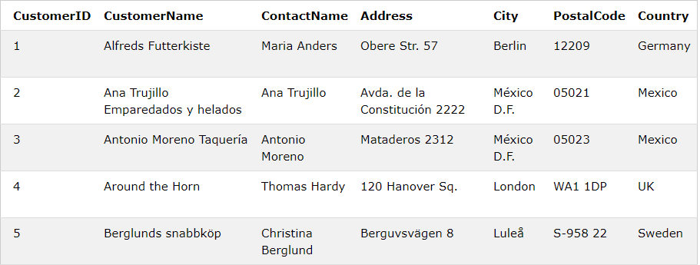
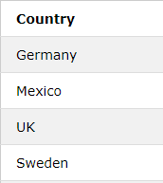
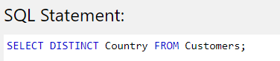

Slide 8
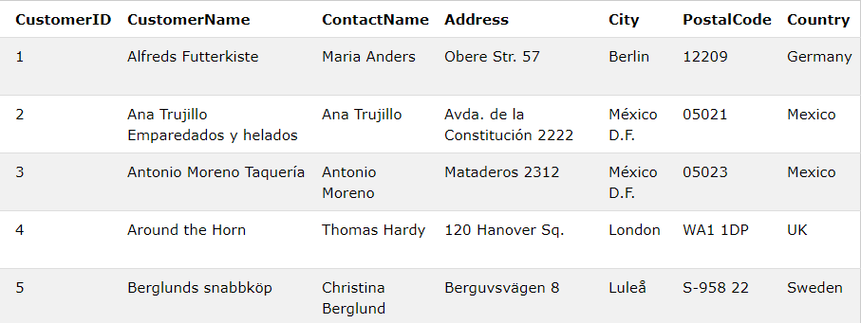
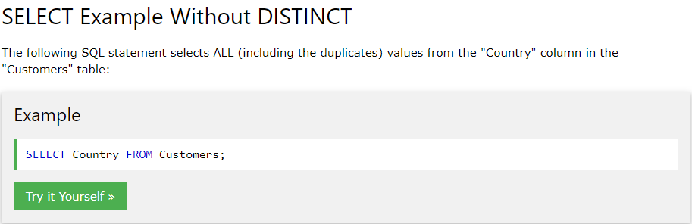
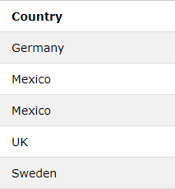

Slide 9
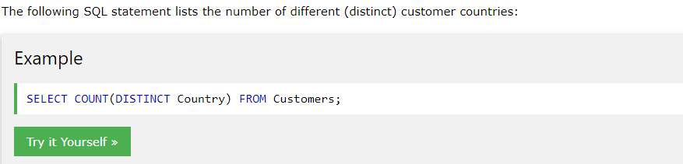

Slide 10
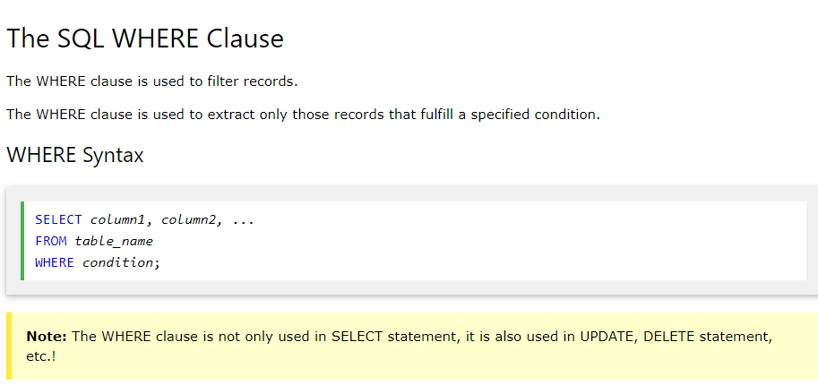

Slide 11
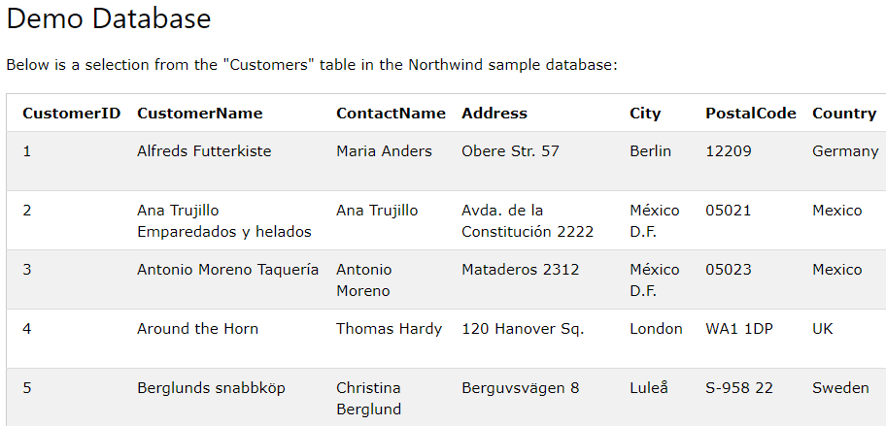
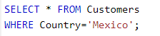
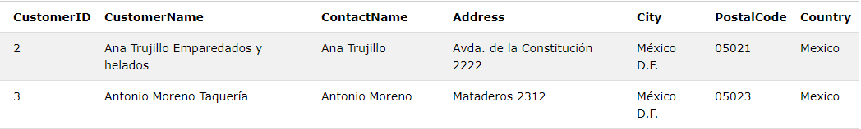

Slide 12
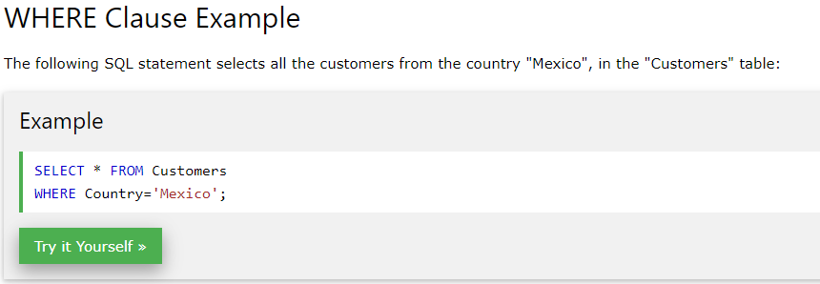

Slide 13
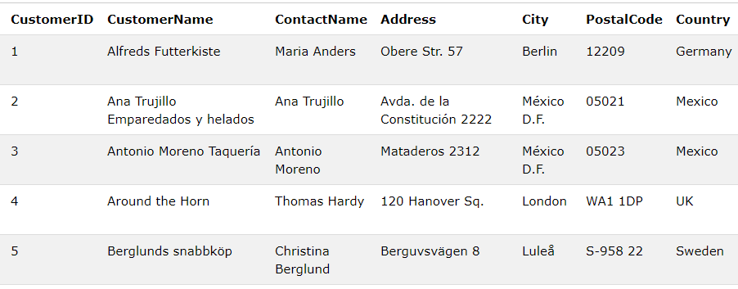
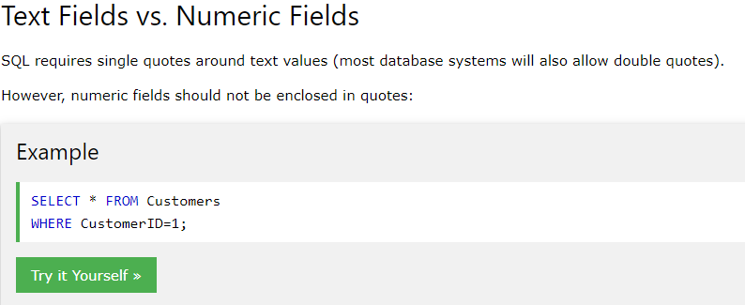
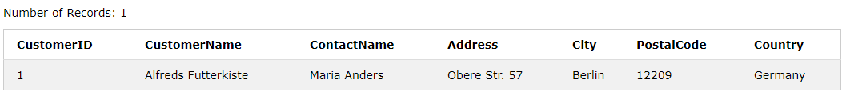

Slide 14
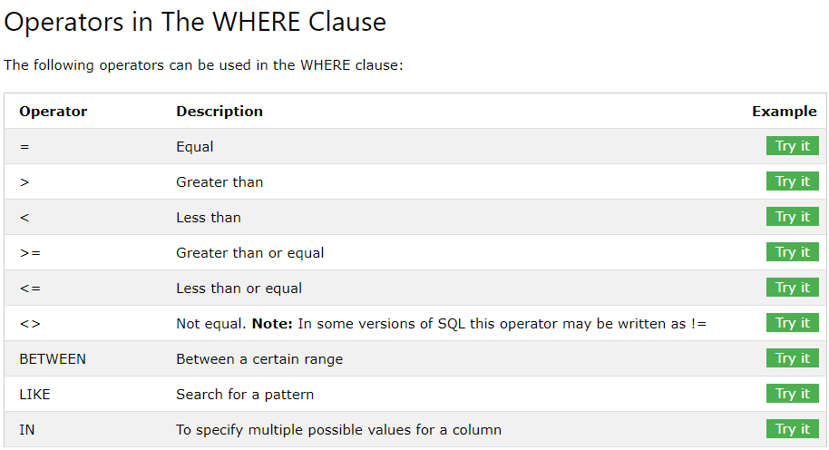

Slide 15
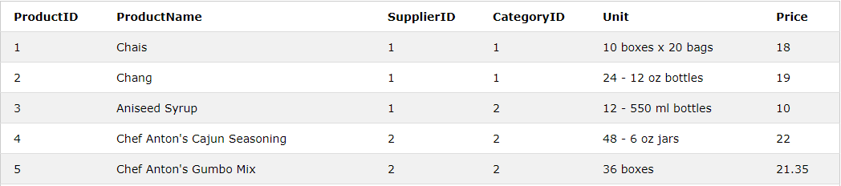
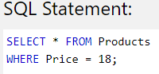

Slide 16

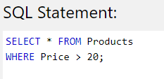
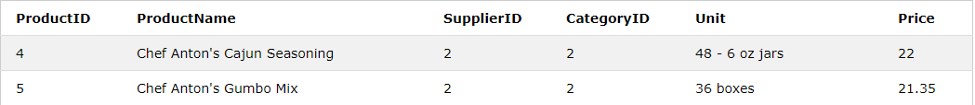

Slide 17
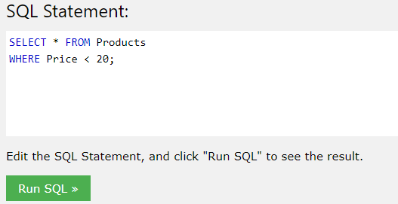
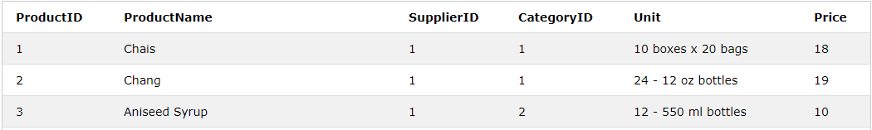

Slide 18
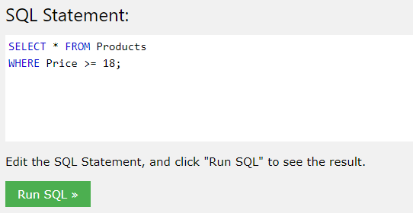
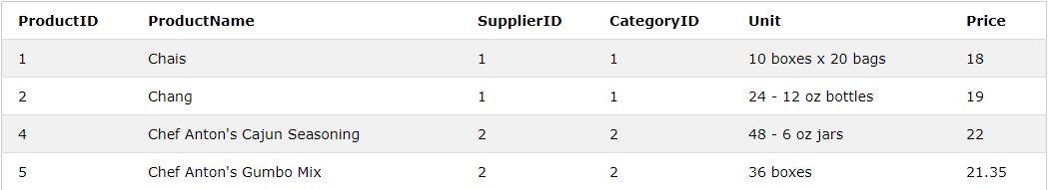

Slide 19
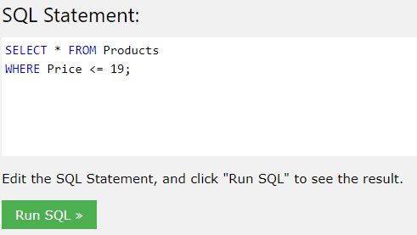
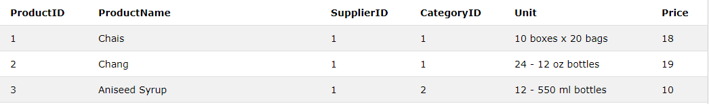

Slide 20
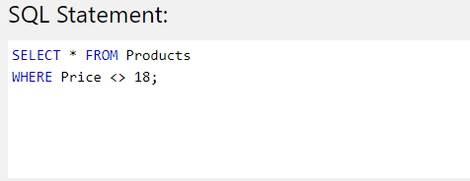
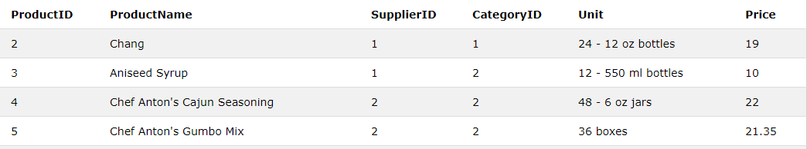

Slide 21
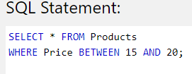
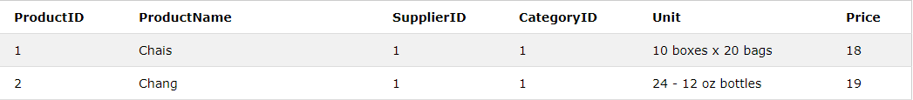
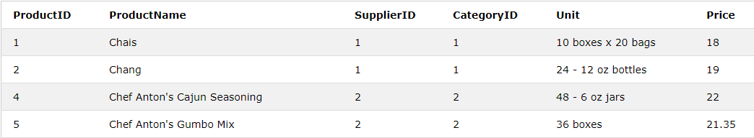
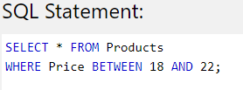

Slide 22
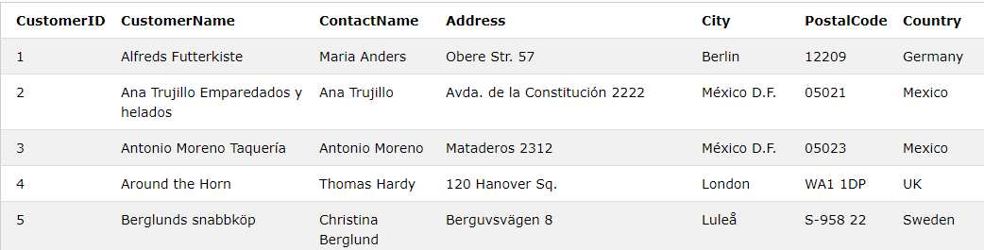
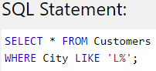
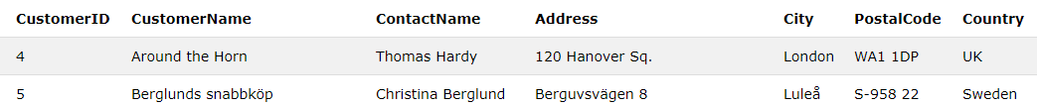
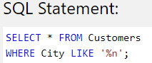
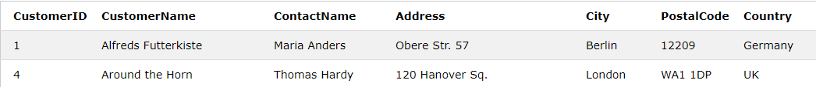
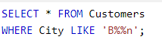

Slide 23
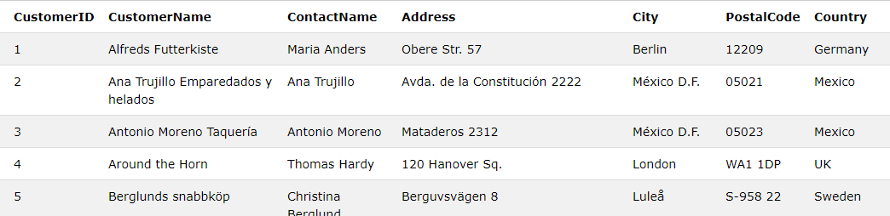
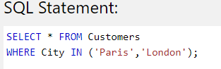

Slide 24
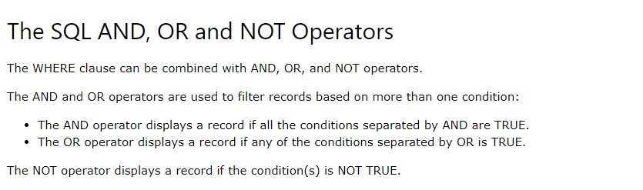



Slide 25



Slide 26





Slide 27



Slide 28



Slide 29



Slide 30





Slide 31





Slide 32




Slide 33




Slide 34



Slide 35



Slide 36
INSERT

Slide 37



Slide 38





Slide 39




Slide 40



Slide 41




Slide 42




Slide 43
UPDATE

Slide 44


Slide 45




Slide 46




Slide 47




Slide 48
DELETE

Slide 49


Slide 50




Slide 51



Slide 52
MIN MAX

Slide 53


Slide 54





Slide 55





Slide 56
Count average sum

Slide 57



Slide 58






Slide 59


Slide 60





Slide 61



Slide 62



Slide 63




Slide 64


Group BY

Slide 65





Slide 66




Slide 67
LIKE

Slide 68


Slide 69


Slide 70




Slide 71




Slide 72


Slide 73



Slide 74


Slide 75



Slide 76


Slide 77


Slide 78



Slide 79


Slide 80



Slide 81



Slide 82


Slide 83


Slide 84


Slide 85


Slide 86



Slide 87
IN

Slide 88


Slide 89



Slide 90



Slide 91


Slide 92
BETWEEN

Slide 93


Slide 94





Slide 95



Slide 96
ELIAS

Slide 97


Slide 98


Slide 99




Slide 100



Slide 101





Slide 102




Slide 103




Slide 104



Slide 105


Slide 106



Slide 107




create table Student(sid int ,sname varchar(10),gpa number(2,1),sizehs int,dob date);insert into student values(123,'amy',3.9,1000,'26-jun-96');insert into student values(234,'bob',3.6,1500,'7-apr-95');insert into student values(345,'craig',3.5,500,'4-feb-95');insert into student values(456,'doris',3.9,1000,'24-jul-97');insert into student values(567,'edward',2.9,2000,'21-dec-96');insert into student values(678,'fay',3.8,200,'27-aug-96');insert into student values(789,'gary',3.9,800,'8-oct-96');insert into student values(987,'helen',3.7,800,'27-mar-97');insert into student values(876,'irene',3.9,400,'7-mar-96');insert into student values(765,'jay',2.9,1500,'8-aug-98');insert into student values(654,'amy',3.9,1000,'26-may-96');insert into student values(543,'craig',3.4,2000,'27-aug-98');--select * from apply;create table college(cname varchar(10),state varchar(10),enrollment int);insert into college values('stanford','ca',15000);insert into college values('Berkeley','ca',36000);insert into college values('mit','ma',10000);insert into college values('cornell','ny',21000);insert into college values('harvard','ma',50040);create table apply(sid int ,cname varchar(10),major varchar(20),decision char(1));insert into apply values(123,'stanford','cs','y');insert into apply values(123,'stanford','ee','n');insert into apply values(123,'berkeley','cs','y');insert into apply values(123,'cornell','ee','y');insert into apply values(234,'berkeley','biology','n');insert into apply values(345,'mit','bioengineering','y');insert into apply values(345,'cornell','bioengineering','n');insert into apply values(345,'cornell','cs','y');insert into apply values(345, 'cornell','ee','n');insert into apply values(678,'stanford','history','y');insert into apply values(987,'stanford','cs','y');insert into apply values(987,'berkeley','cs','y');insert into apply values(876,'stanford','cs','n');insert into apply values(876,'mit','biology','y');insert into apply values(876,'mit','marine biology','n');insert into apply values(765,'stanford','history','y');insert into apply values(765,'cornell','history','n');insert into apply values(765,'cornell','psychology','y');insert into apply values(543,'mit','cs','n');

Slide 108


Slide 109





Slide 110






Slide 111







Slide 112






Slide 113










Slide 114










Slide 115





Slide 116



